Slide 1
Automated toll collection and theft detection using Rfid and image processing
CPG No. 63
Shivam Bhushan – 101783039
Sehajbir Singh – 101603309
Shervil Gupta – 101603312
Shivam Mittal – 101603316
Mentor – Dr. Deepshikha Tiwari

Slide 2
Table of contents
S. No. | Topic | Slide No.
1 | Background of project | 3
2 | Objectives | 4
3 | Methodology to meet the objectives | 5-6
4 | Scope and utility of project | 7
5 | Standards to be used | 8
6 | Constraints and assumptions | 9
7 | Architecture of the project | 10
8 | Techniques and tools used | 11
9 | Professional and technical learning | 12
10 | Proposed toll deduction Algorithm | 13
11 | Theft and tampering Detection | 14
12 | Outcome | 15

Slide 3
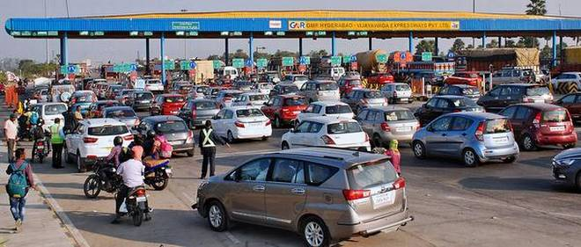
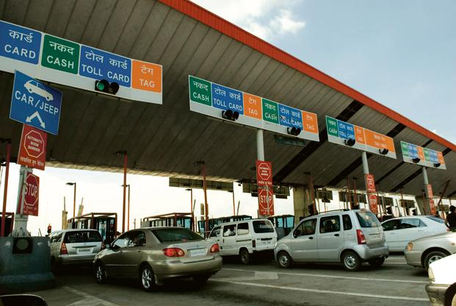
Background of project
Long Lines at Toll Plazas.
Minimal reduction in waiting time even
after implementation of modern systems like Fastag.

Slide 4
oBJECTIVES
Faster transit on Toll Roads.
Cashless Toll Deductions.
Effective Theft and Tampering Detection.
Time and Fuel Savings.
Similar Technologies can be implemented for automated parking systems.

Slide 5
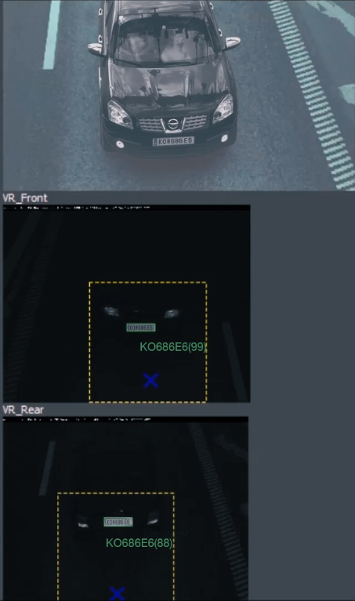
Methodology to meet the objectives
Detection of Front and Rear Vehicle Identification Plate Using OCR.

Slide 6
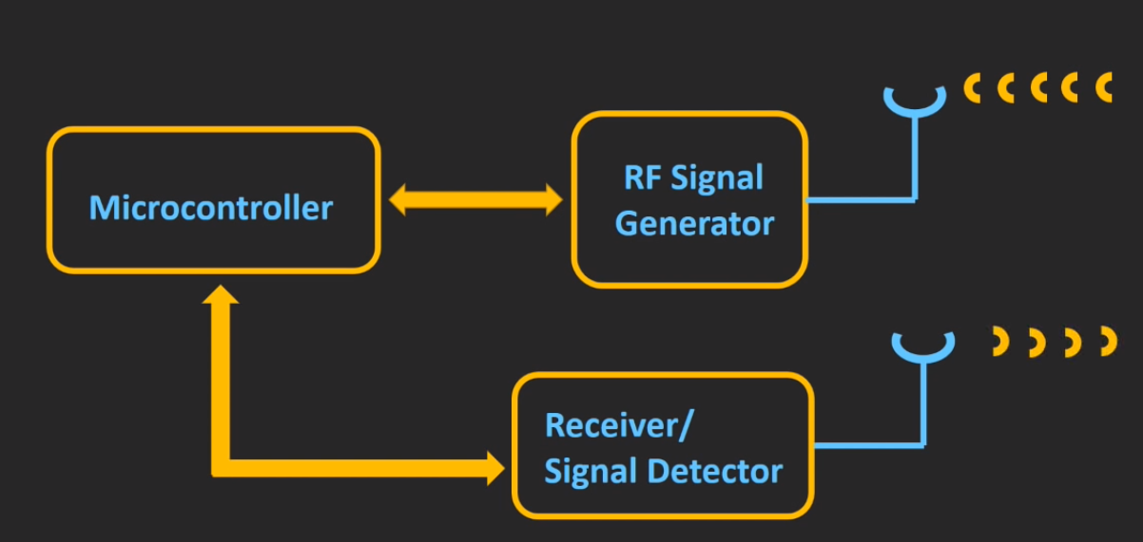
Methodology to meet the objectives
Radio Frequency
Identification System.

Slide 7
Scope and utility of project
Eliminating any queues on Toll Plazas by completely removing all barriers on the road.
True implementation of Cashless transactions at Toll Plazas.
Implementing an effective and fool proof Theft detection and Tampering detection System.
Auto Generation and dispatch of E-challan to defaulter.

Slide 8
Standards to be used
ISO 20954 – Image Stabilization standard for camera.
ISO 20490 – Auto-focus standard for camera.
ISO 19093 – Low-light performance.
IEEE 802.11 – Wireless Connection.
ISO and EPCglobal standards for RFID.

Slide 9
Constraints and assumptions
No vehicle Identification plate is damaged beyond recognition.
It’s made mandatory by RTO to get the RFID system installed.
The vehicle should not be going at an exceptionally high speed.
Range and Angle of Camera.

Slide 10

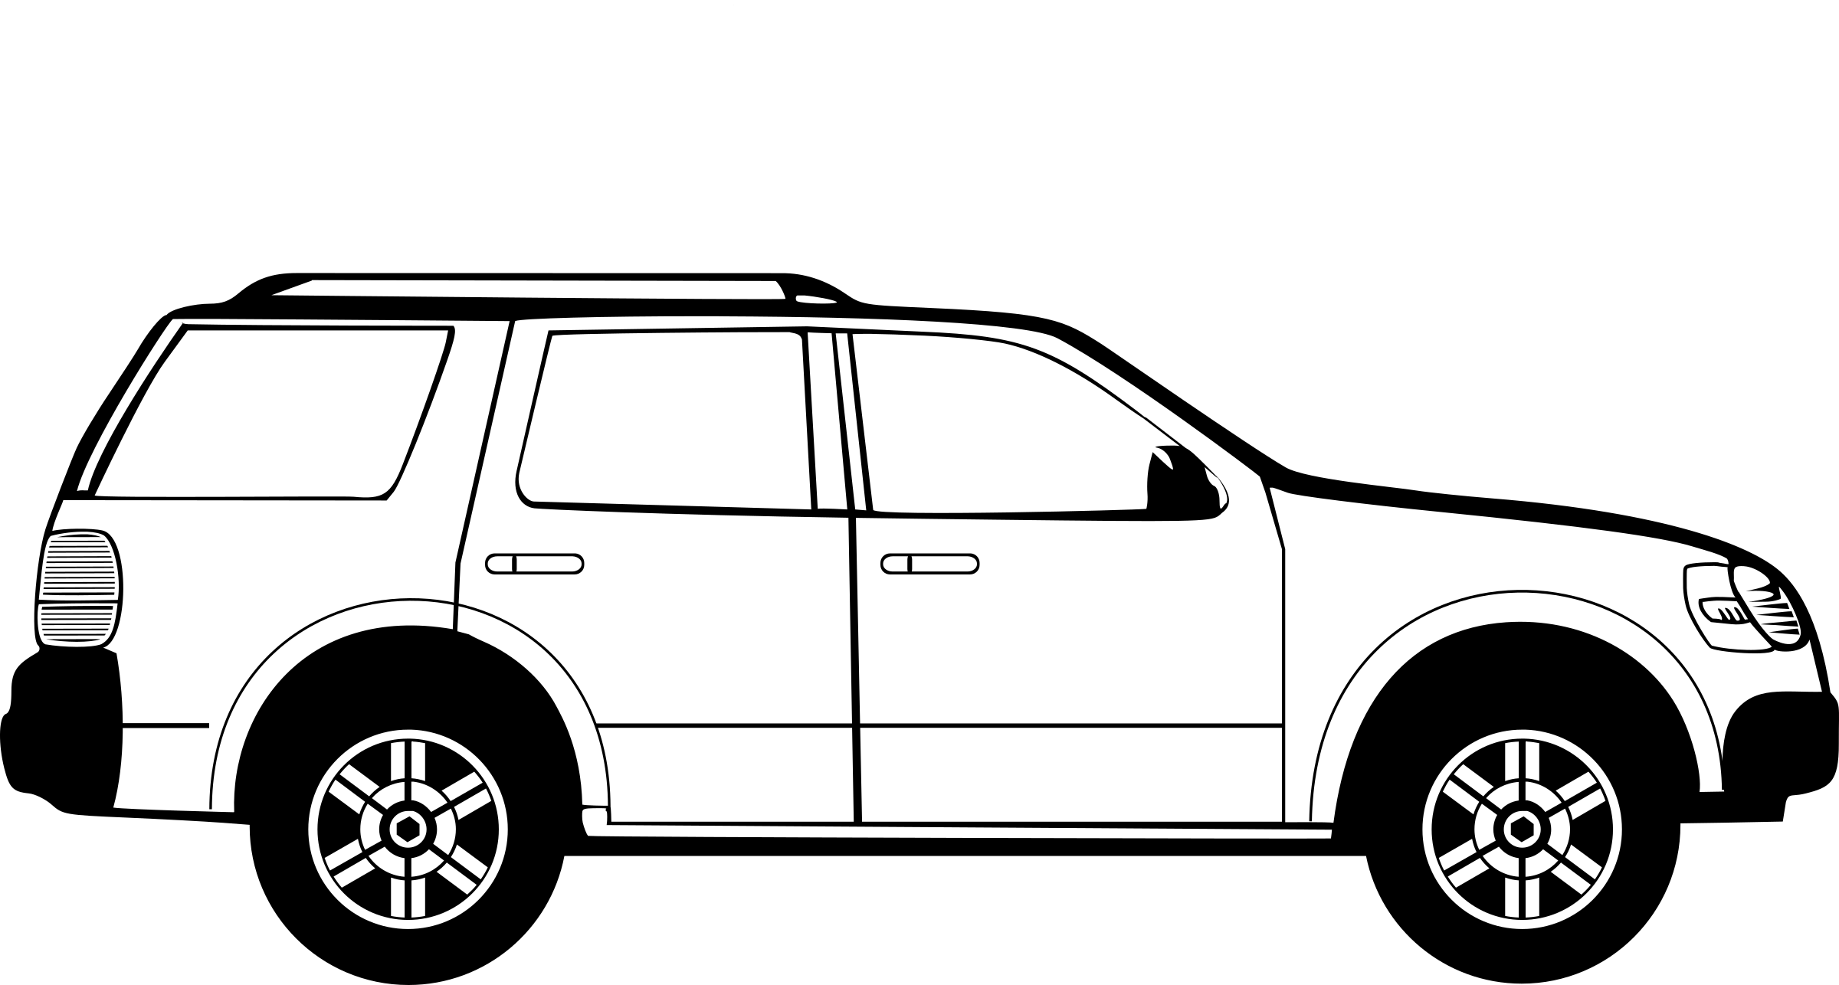
Architecture of the project
Internet
Connection
RFID Scanner
Cameras to Scan ID plates
Processing Unit located at the
Toll plaza
Central Database
Containing Details of
All vehicles

Slide 11
Techniques and tools used
Radio Frequency Identification (RFID) Technique.
Optical Character Recognition (OCR) Technique.
Image Processing Technique
Slow Motion High Definition Cameras.
Raspberry Pi (or similar single board computer).
Web and Mobile Portal.

Slide 12
Professional And technical learning
Processing Images of moving vehicles and extracting features of these images.
Processing of Information Incoming from RFID transmitter.
Using Internet of Things to track the vehicle location from the user portal.

Slide 13



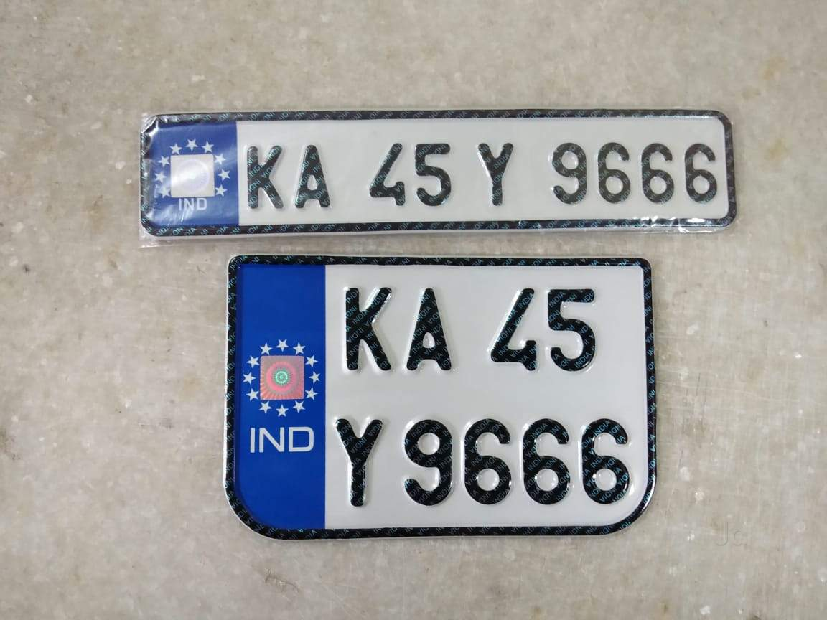
Proposed toll deduction Algorithm
Processing Unit at
Toll Plaza
Prepaid Account
Linked to RFID
Prepaid Account Linked to Vehicle Identification Plate
E-Challan Sent to
User’s Portal

Slide 14
Theft and tampering Detection
For all Reported as Missing or Stolen Vehicle, as mentioned by the User on the portal, whenever such a vehicle crosses any Toll Plaza, an automated notification will be sent to the nearest PCR.
All Data collected from RFID and the Vehicle Identification Plates will be cross-referenced with each other to detect any anomaly due to data mismatch. This will result in a tampering notification to be sent to User and Operation Unit Portal.
Notification of a vehicle crossing any Toll Plaza will be sent to the User Portal in real time.

Slide 15
Outcome
Faster transit on Toll Roads.
Cashless Toll Deductions.
Effective Theft and Tampering Detection.
Time and Fuel Savings.
Similar Technologies can be implemented for automated parking systems.

